Slide 1

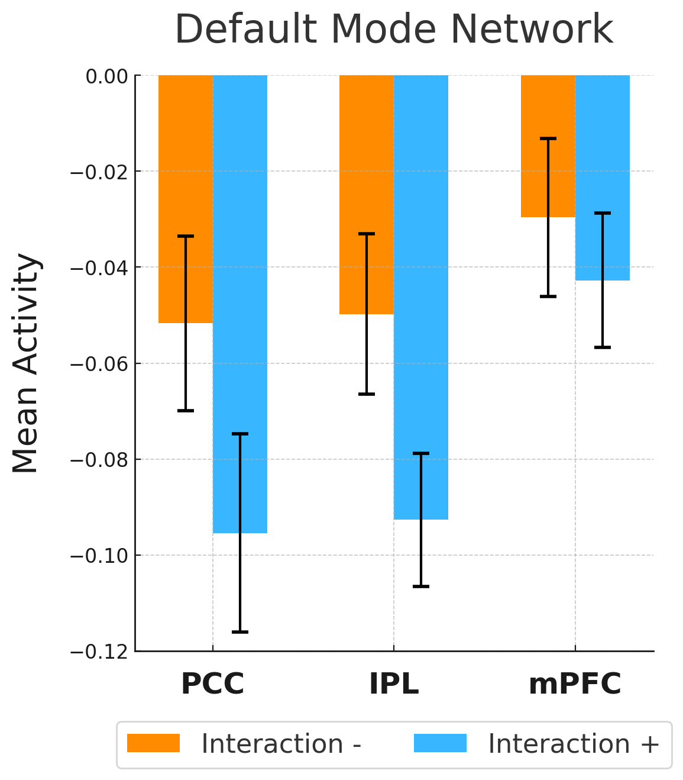
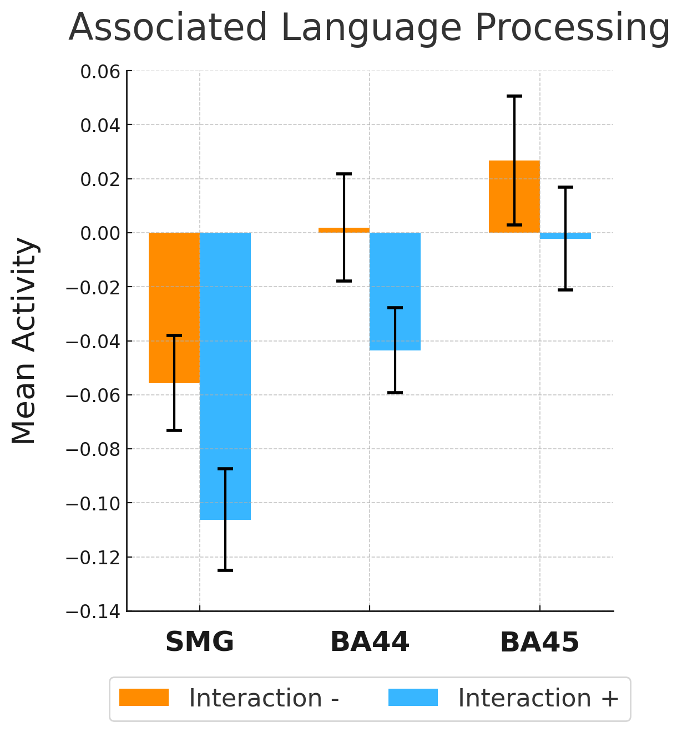
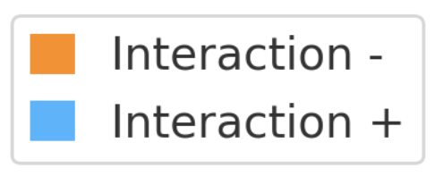
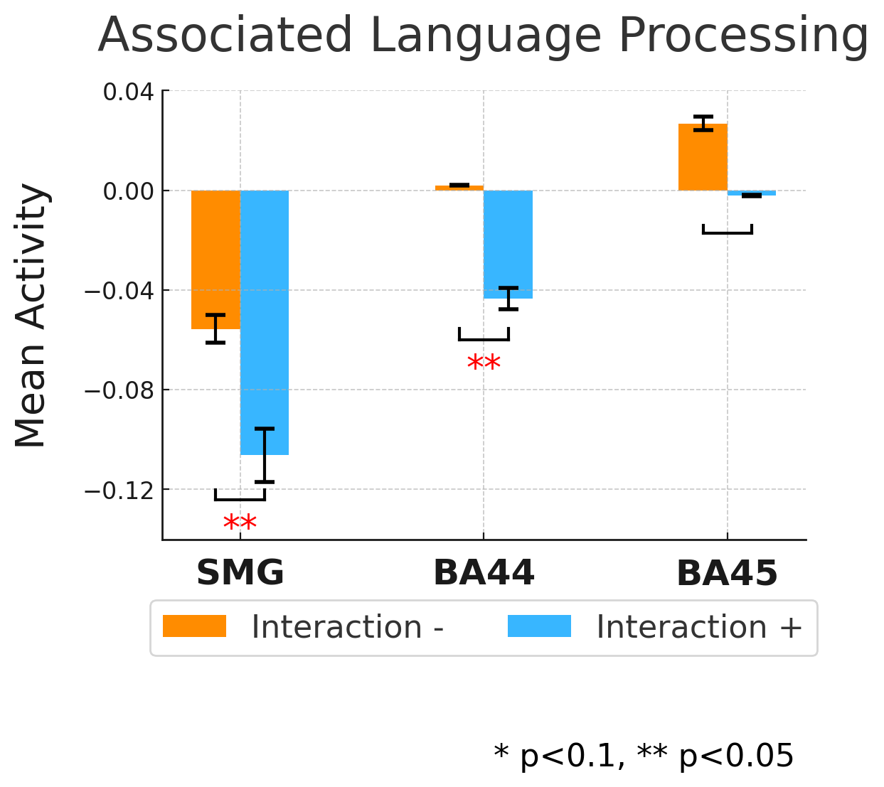

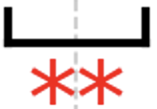

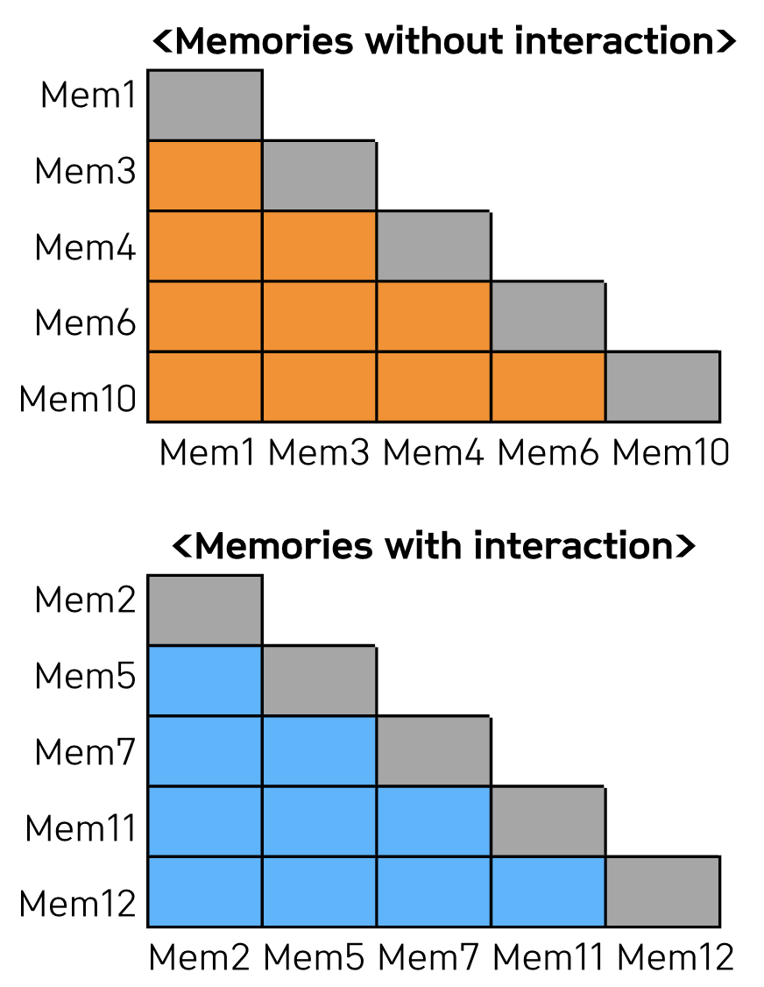
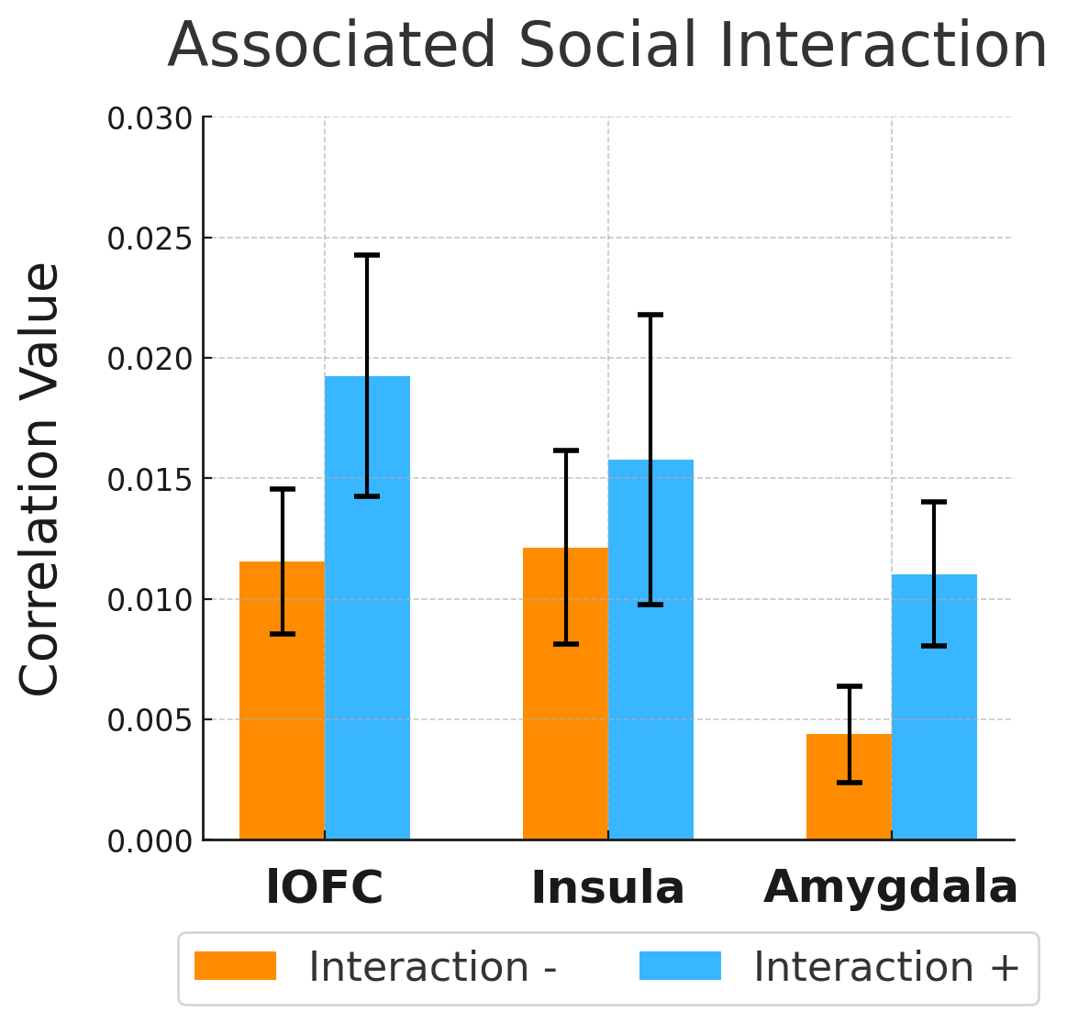
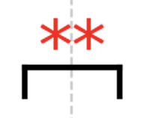





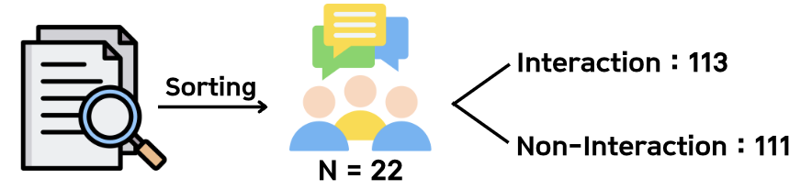

Neural Activity Differences in the Retrieval of Memories With and Without Social Interaction
서울대학교 자연과학대학 생명과학부
2022-17619 조현희 (gusgml520@snu.ac.kr)
지도 교수 : 서울대학교 심리학과 이수현 | 조교 : 신인호
INTRODUCTION
RESULTS
We experience diverse situations daily, from self-reflective introspection to social interactions and tasks.
Introspection is known to involve the default mode network (DMN), which consists of key hubs such as the posterior cingulate cortex (PCC), closely connected to the inferior parietal lobule (IPL), and the medial prefrontal cortex (mPFC ; Buckner et al., 2008). In contrast, social activities are associated with regions such as the amygdala, orbitofrontal cortex (OFC), and insula (Adolphs, 2009).
Some of these moments are encoded as memories. Do similar neural mechanisms underlying these situations also play a role during memory retrieval? This study aims to investigate the representational differences in the retrieval of memories with and without social interaction.
Comparison of Neural Activity
* p<0.1, ** p<0.05
Two-tailed T-test
Neural Activity data for posterior cingulate cortex (PCC),
inferior parietal lobule (IPL), medial prefrontal cortex (mPFC),
supramarginal gyrus (SMG), and BA44/BA45 of Broca’s area
2) Comparison of Correlations
METHODS
Interview & fMRI Experiment
* p<0.1, ** p<0.05
Two-tailed T-test
Correlation data for lateral orbitofrontal cortex (lOFC), insula, and amygdala
DISCUSSIONS
Interpretation of Results
The results highlight the involvement of the PCC and IPL in self-referential processing and suggest that the lOFC plays a critical role in social situational processing.
Notably, regions associated with language processing showed greater activation during the retrieval of memories without interaction, which is likely attributed to. self-referential inner speech during the recall of self-focused memories
The lack of significant differences in the insula and amygdala likely reflects the absence of empathizing with others in most memories and the lack of emotional facial expression recognition during memory retrieval.
Future Direction
Segmenting memories into those that elicit positive emotions and those that evoke negative emotions reduces variability in the analysis and enhances interpretability.
Each participant recalled 12 distinct memories, four times each.
2) Sorting Memories
Sorting criterion: Whether there was direct communication with others, such as conversations or message exchanges.
✓ Memories such as being late for an appointment, which involve interaction as a background but are experienced alone, were excluded from the analysis.
3) fMRI Data Analysis
Mean activation for memories with and without interaction was analyzed for each participant. Furthermore, multivoxel pattern analysis (MVPA) was conducted to examine shared representations of social interaction.
REFERENCES
Adolphs, R. (2009). The social brain: Neural basis of social knowledge. Annual Review of Psychology, 60, 693–716.
Buckner, R. L., Andrews-Hanna, J. R., & Schacter, D. L. (2008). The brain’s default network: Anatomy, function, and relevance to disease. Annals of the New York Academy of Sciences, 1124(1), 1–38.
* The participant interview data and fMRI data were provided by Professor Sue-Hyun Lee's "Memory and Cognition Lab."

